Slide 1

Ontology V13 Review

Slide 2

AGENDA
V13 Additions
Metadata Changes
New Classes
New Object Properties (Relationships)

Slide 3
V13 Element Additions
Elements without Options Sets
    All elements without option sets are added as Data Properties
Elements with Option Sets
    All elements with option sets are added as Class/Concept Schemes and each individual option set is added as a Named Individual
From an Ontology review perspective, these cannot be changed – the review of new elements occurs through the OSC Elements repository.

Slide 4
Metadata Additions/Changes
New – Annotation Properties
    Text Format
    Minimum Count
    Maximum Count
    Maximum Length
    Minimum Inclusive Value
    Maximum Inclusive Value
    Decimal Places

Slide 5
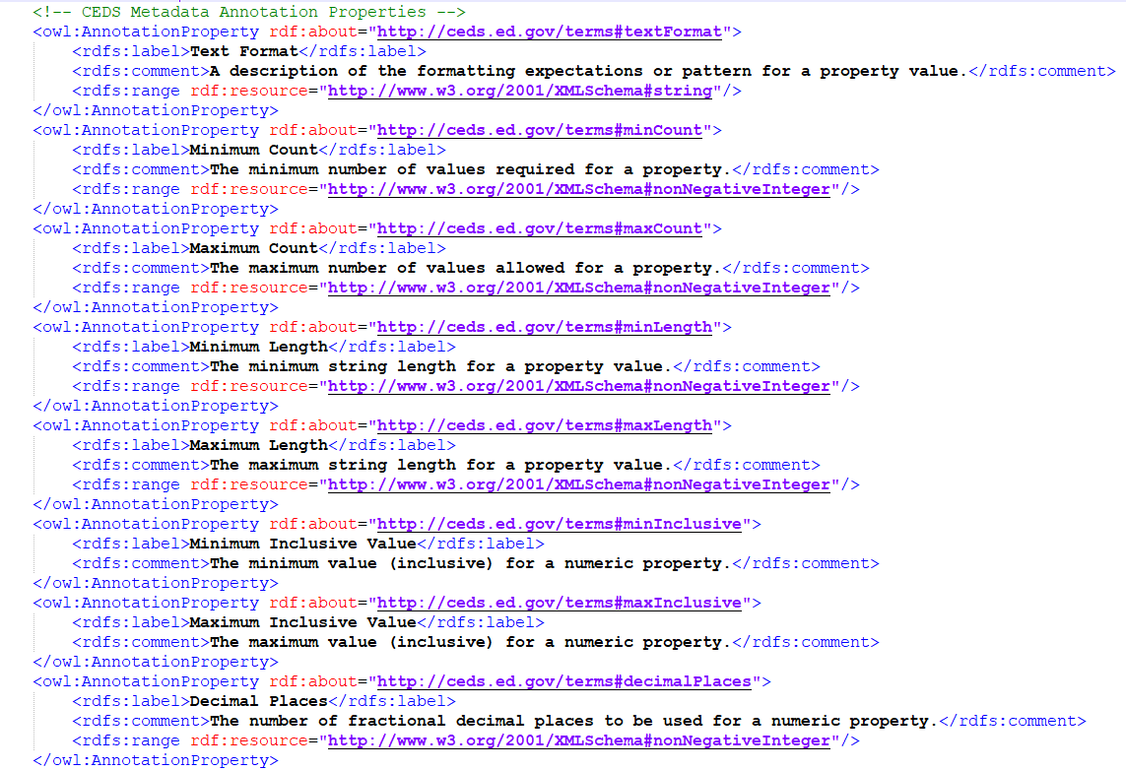
Metadata Additions/Changes
New – Annotation Properties
    Text Format
    Minimum Count
    Maximum Count
    Maximum Length
    Minimum Inclusive Value
    Maximum Inclusive Value
    Decimal Places

Slide 6
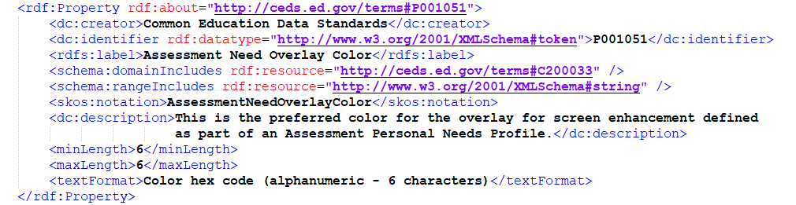
Metadata Additions/Changes

Slide 7
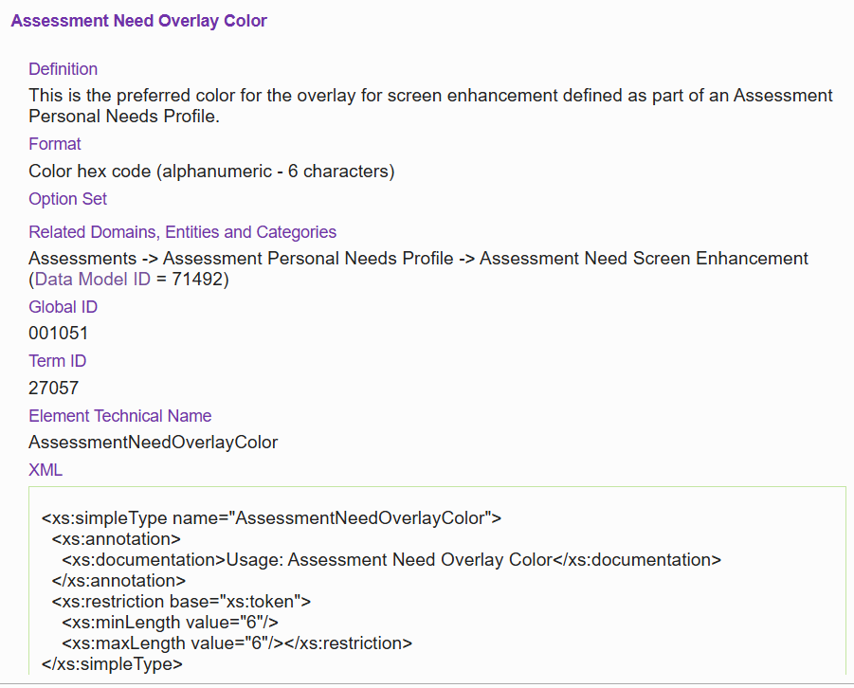
Metadata Additions/Changes

Slide 8
Metadata Additions/Changes
New – Annotation Properties
    Text Format
    Minimum Count
    Maximum Count
    Maximum Length
    Minimum Inclusive Value
    Maximum Inclusive Value
    Decimal Places

Slide 9
Metadata Additions/Changes
New – Annotation Properties
New – Edit History
    Edit History – as a property that can include all classes, properties, and named individuals
    Edit History Entry – the class
    Change Date
    Change Version
    Change Description
    Issue Link
    Changed By

Slide 10
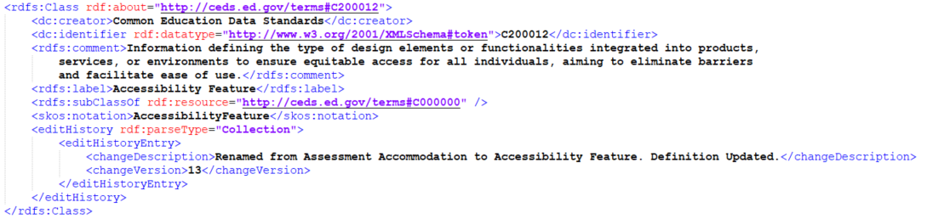
Metadata Additions/Changes
New – Annotation Properties
New – Edit History
    Edit History – as a property that can include all classes, properties, and named individuals
    Edit History Entry – the class
    Change Date
    Change Version
    Change Description
    Issue Link
    Changed By

Slide 11
Class & Property Additions
New - Classes

Slide 12
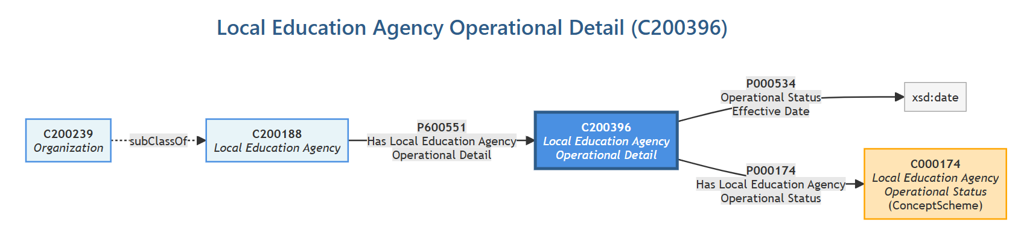
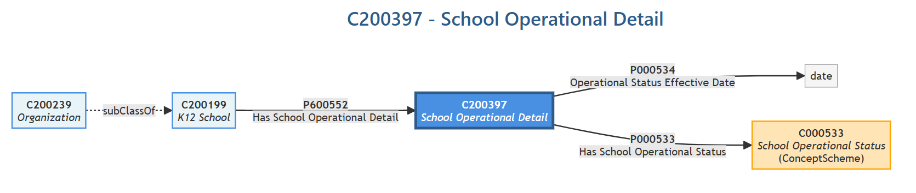

Slide 13
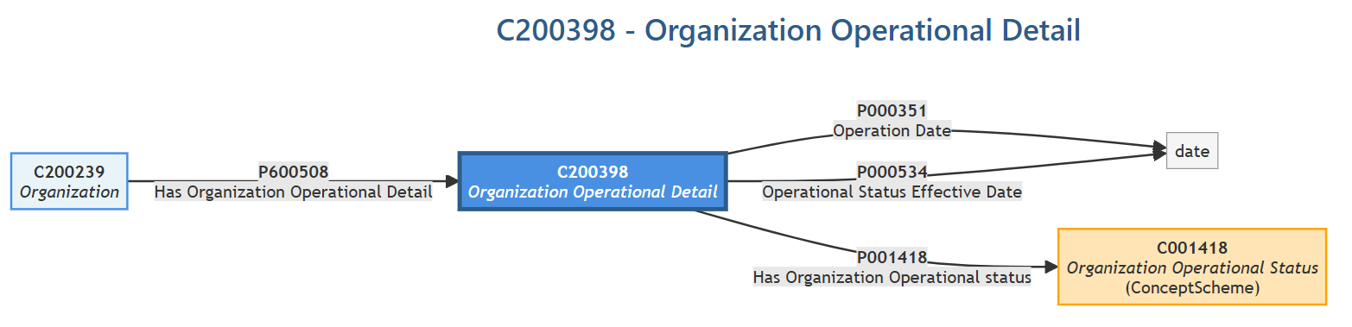
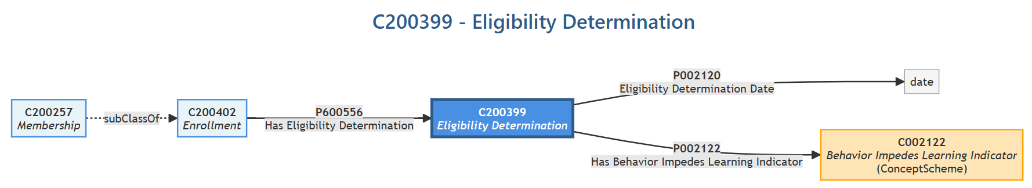

Slide 14
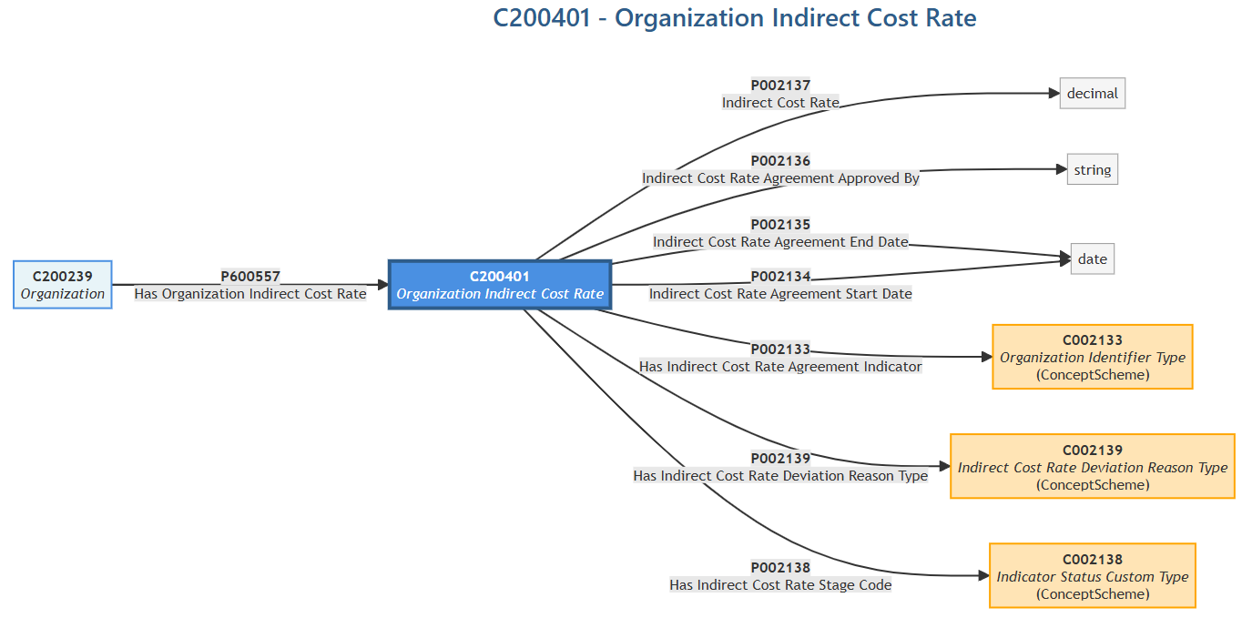

Slide 15
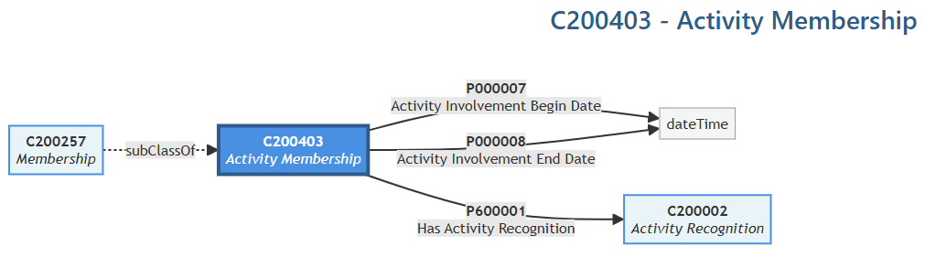


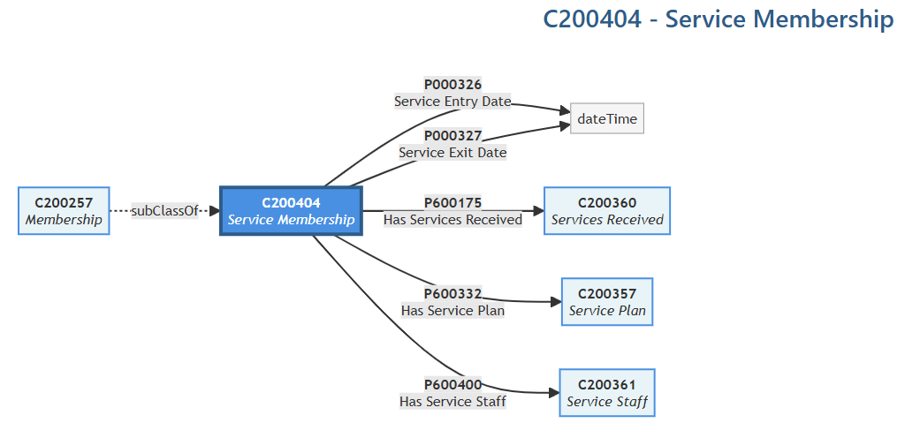


Slide 16

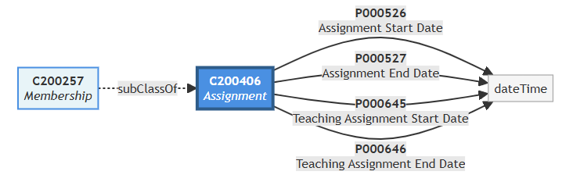

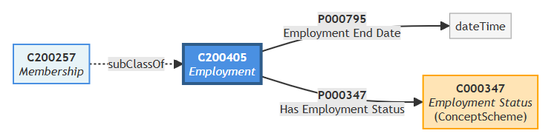

Slide 17
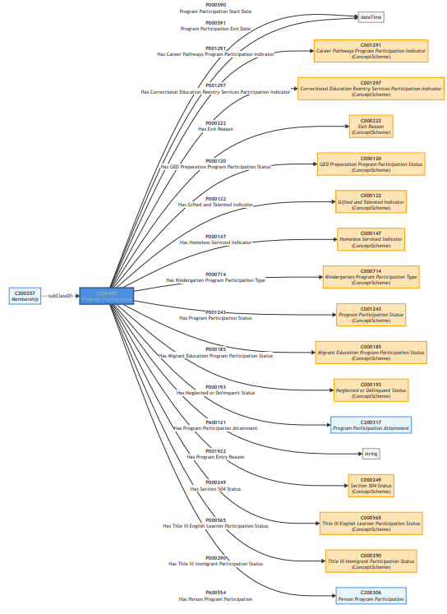

Slide 18
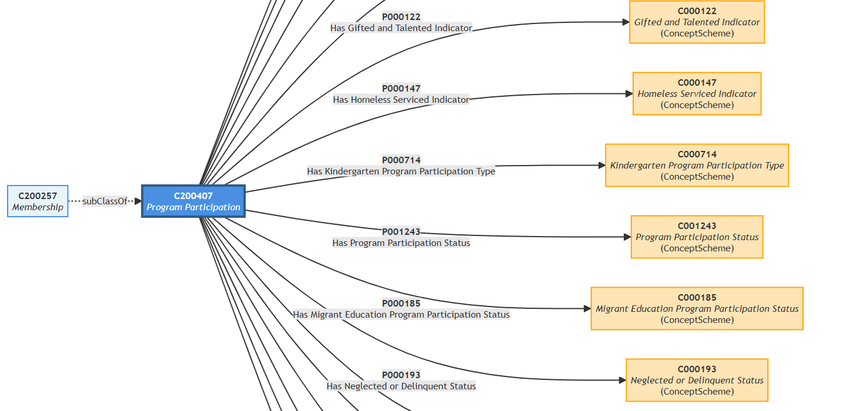
Has Program Participation Migrant
Program Participation Migrant

Slide 19
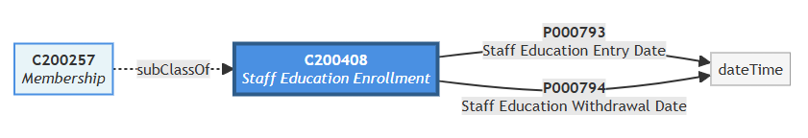
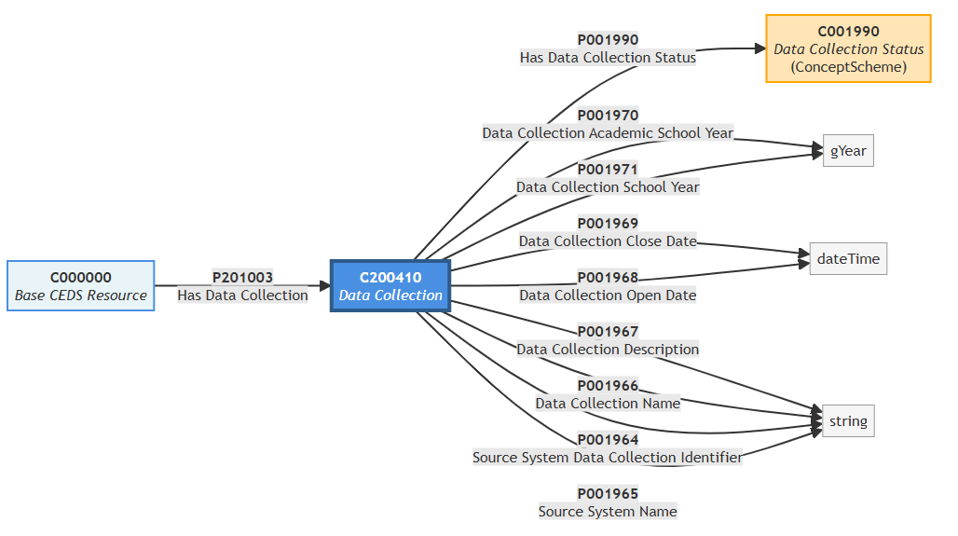


Slide 20
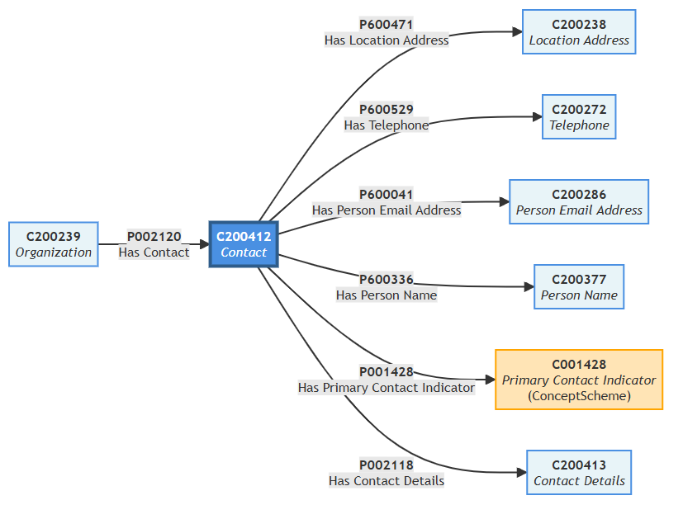


Slide 21

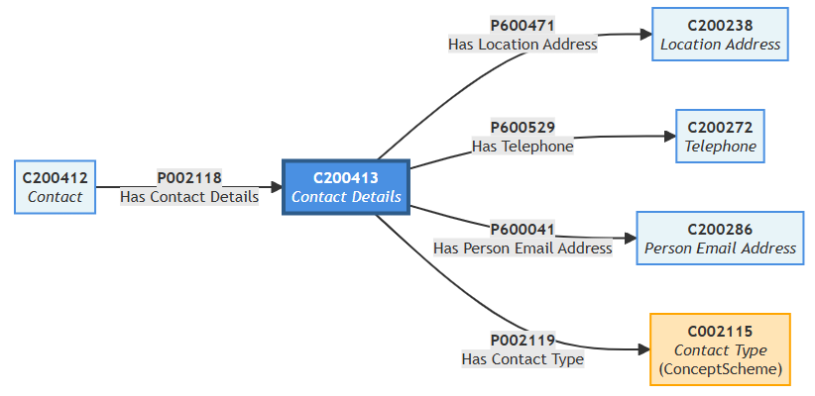

Slide 22

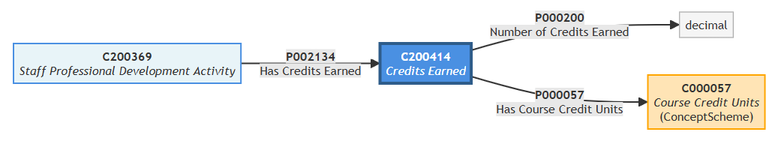
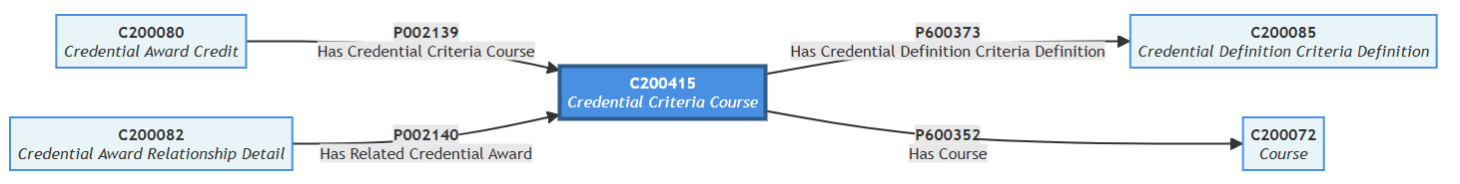

Slide 23
Class & Object Property Additions
New – Classes
New – Object Properties

Slide 24
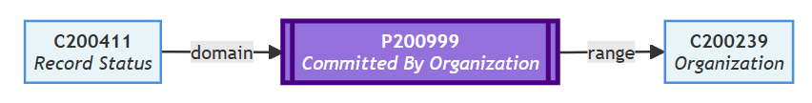



Slide 25
Orphaned

Slide 26

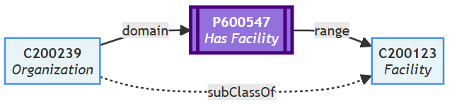

Slide 27

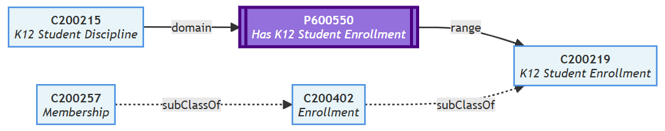

Slide 28
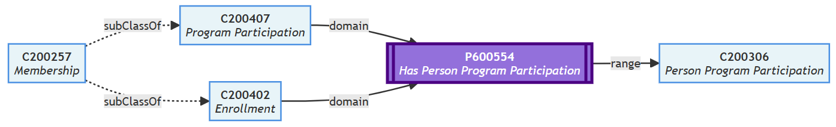
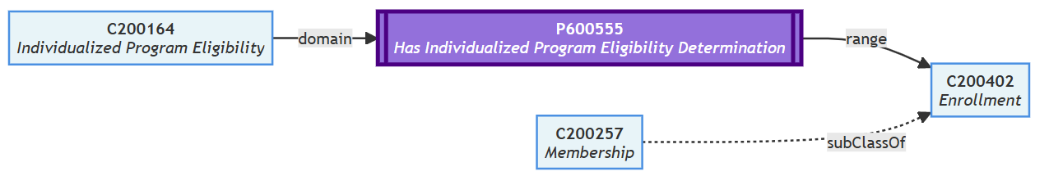
Previous Version – Membership to Has Person Program Participation

